Slide 1
safetyGraphics
An open source framework for evaluation of clinical trial safety
Links: CRAN | GitHub | Demo

Slide 2
Disclaimers
Sample data has been provided for all examples since we are using a cloud-based platform for the workshop. We recommend that you:
safetyGraphics is not Validated or Qualified. Consult with stakeholders at your organization (IT, Compliance, etc.) before using it in your work.
Please don’t use any private data during the workshop.
For more info about security and other technical topics see our FAQ

Slide 3
Agenda
0. Intro To safetyGraphics (20 min)
Hello World (10 min)
Breakout 1
Loading Custom Data (30 min)
Breakout 2
Chart/App Export (10 min)
-------------- Break ------------ (10 min)
4. Creating Custom Charts (1 hr)
Breakout 3 & 4
5. Creating Custom Data Domains (40 min)
6. Chat + Q&A (Also at safetyGraphics Booth during conference)
Beginner
Advanced

Slide 4
00. Intro To safetyGraphics
Quick Group Background and Technical Overview

Slide 5

Interactive Safety Graphics (ISG) Working Group
Sub-team of DIA & ASA-Biopharm Safety Working Group
https://safetygraphics.github.io/

Slide 6




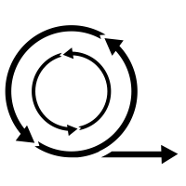


ISG Guiding Principles
Open Source
Highly Collaborative
Interactive
Easy to use
Data Standard Compliant
Agile
Engaging
Notes:
Open Source - Transparent. Customizable. Free!
Highly Collaborative - Clinicians and Programmers working together.
Interactive - Users can explore their data.
Easy to Use - Just open up a webpage.
Easy to Configure - Streamlined configuration with R.
Compliant with Data Standards - Support ADaM and SDTM by default.
Agile - Frequent releases with GitHub.
Engaging - Regular Feedback from users. Pilot testing. Open issue tracking.

Slide 7
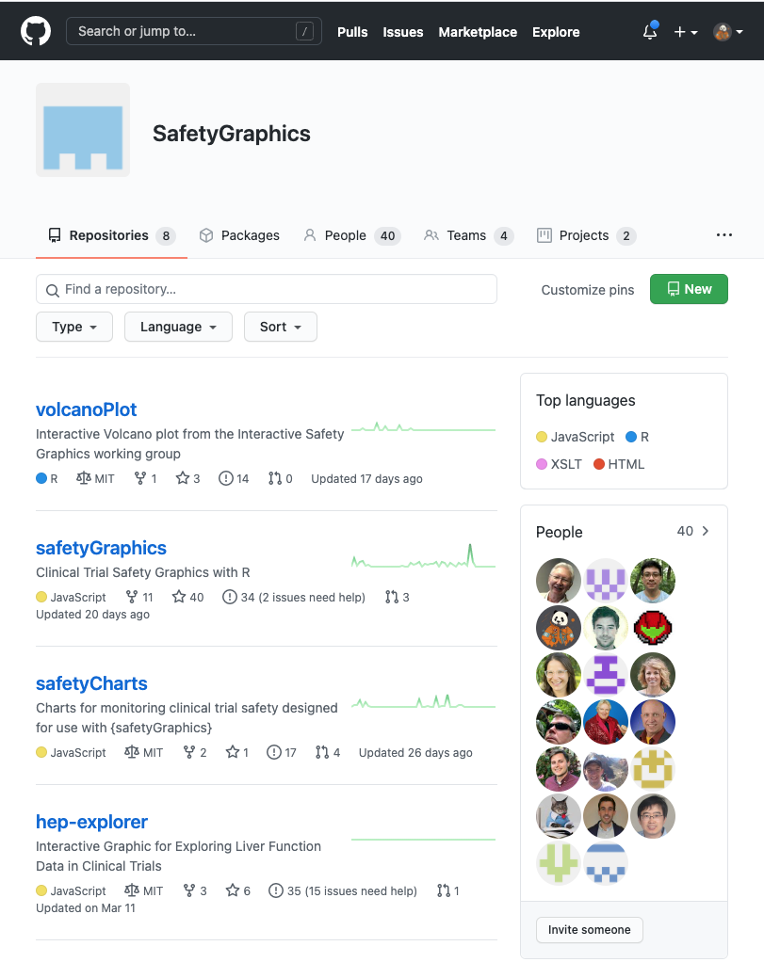
Open and Transparent Online Collaboration
We use a public GitHub site for:
Source Code Storage
Version Control
Testing/QC infrastructure
Issue tracking
Release Tracking
Discussion boards
Meeting Minutes
Project Management (Kanban boards, etc.)
Web-site hosting
Continuous Integration
https://github.com/SafetyGraphics

Slide 8
Moving from Static to Interactive
Phase 0
2012-2018
Phase 1
2018-2019
Establishing an Open-Source Working group
Building a Robust Technical Framework
Phase 2
2019-2021
Interactive Safety Graphics WG
We are here
Phase 3
2021-???
Building Production Workflows

Slide 9
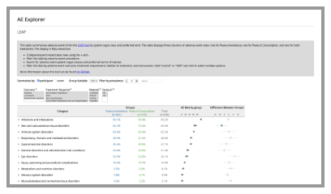
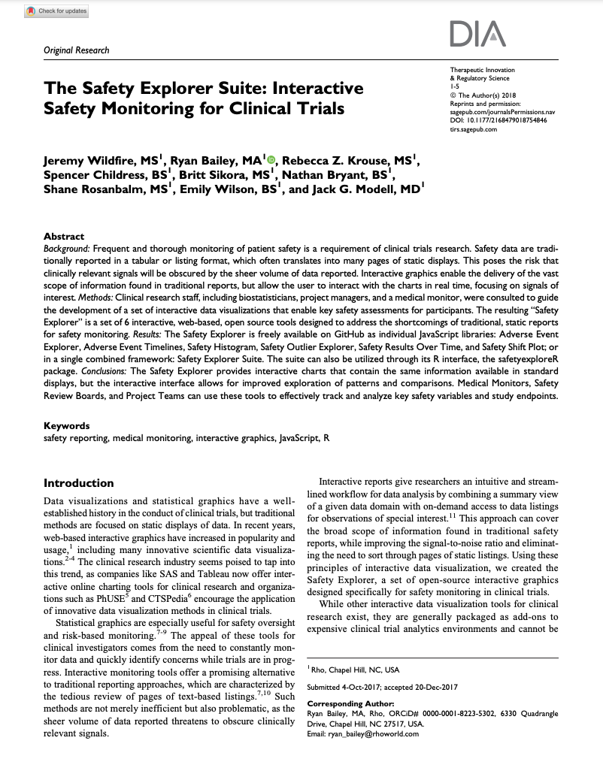
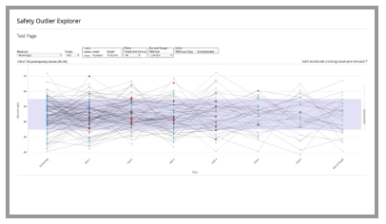
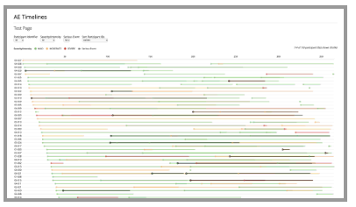
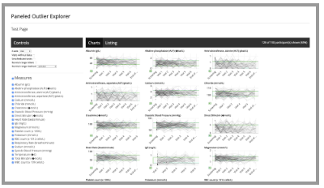
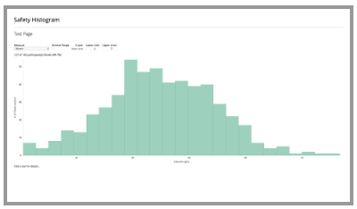
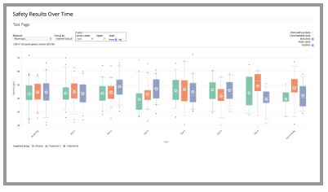
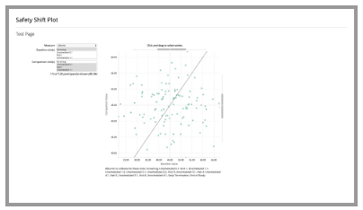
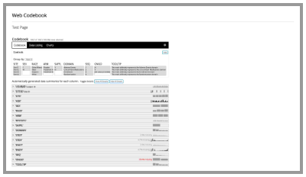
The Safety Explorer Suite: Interactive Safety Monitoring for Clinical Trials, Wildfire et al. 2018
Paper - Repo

Slide 10
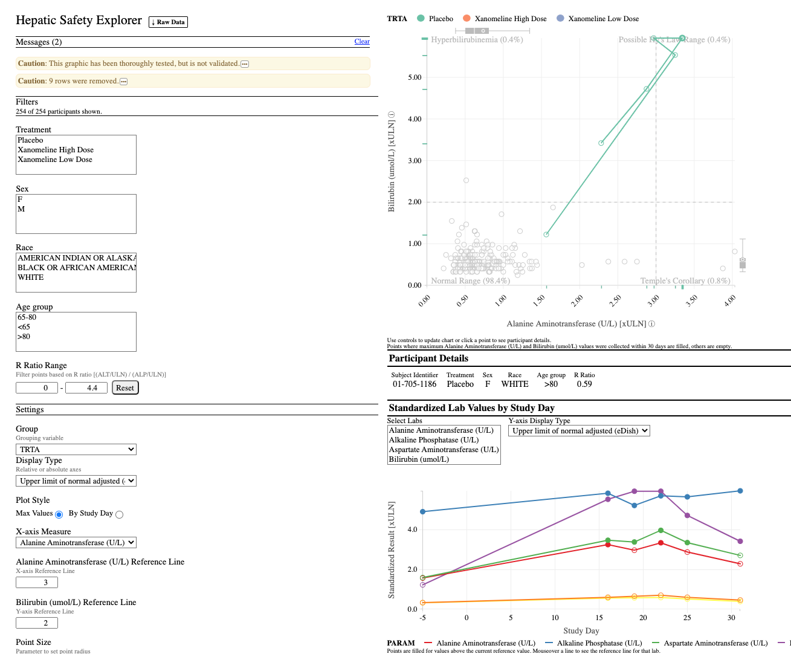
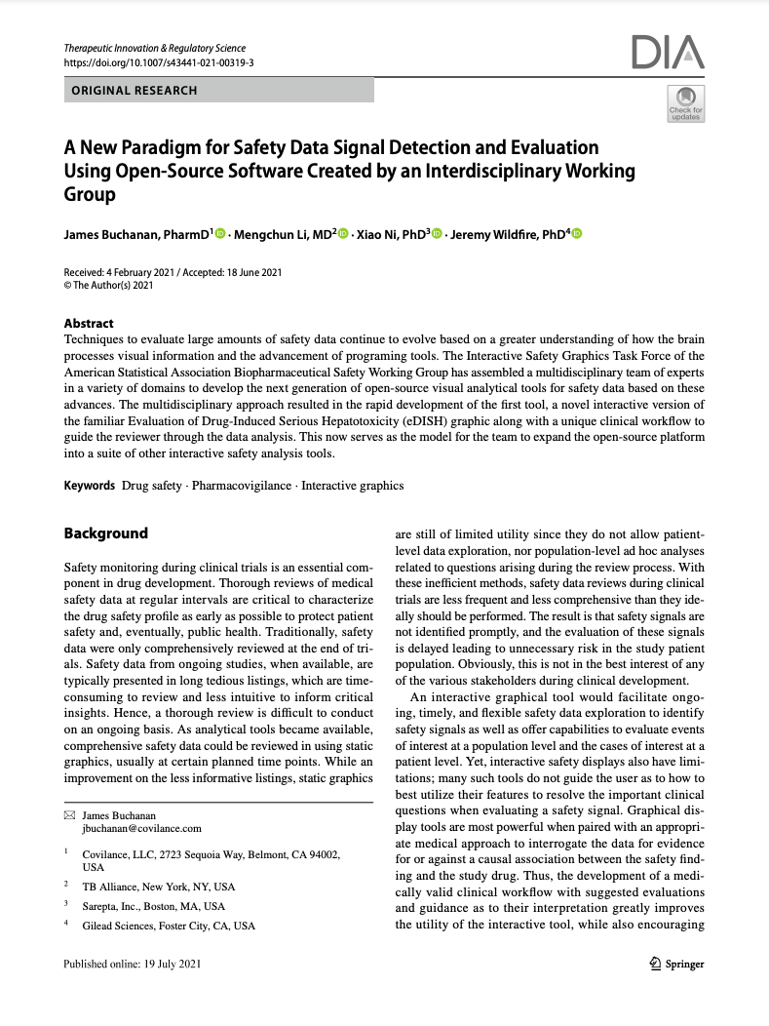
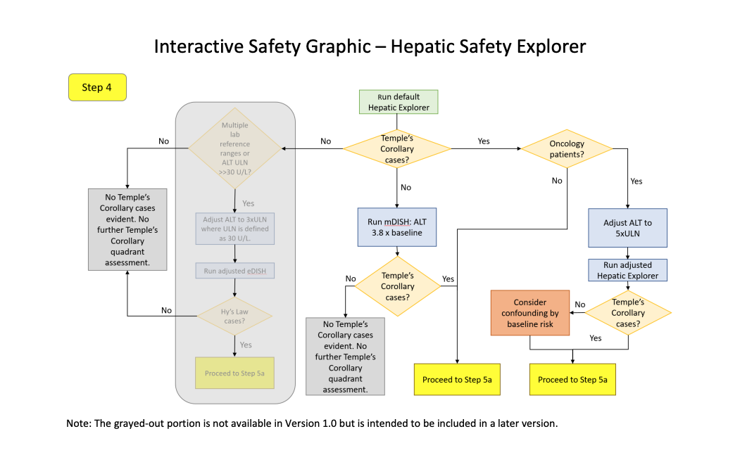
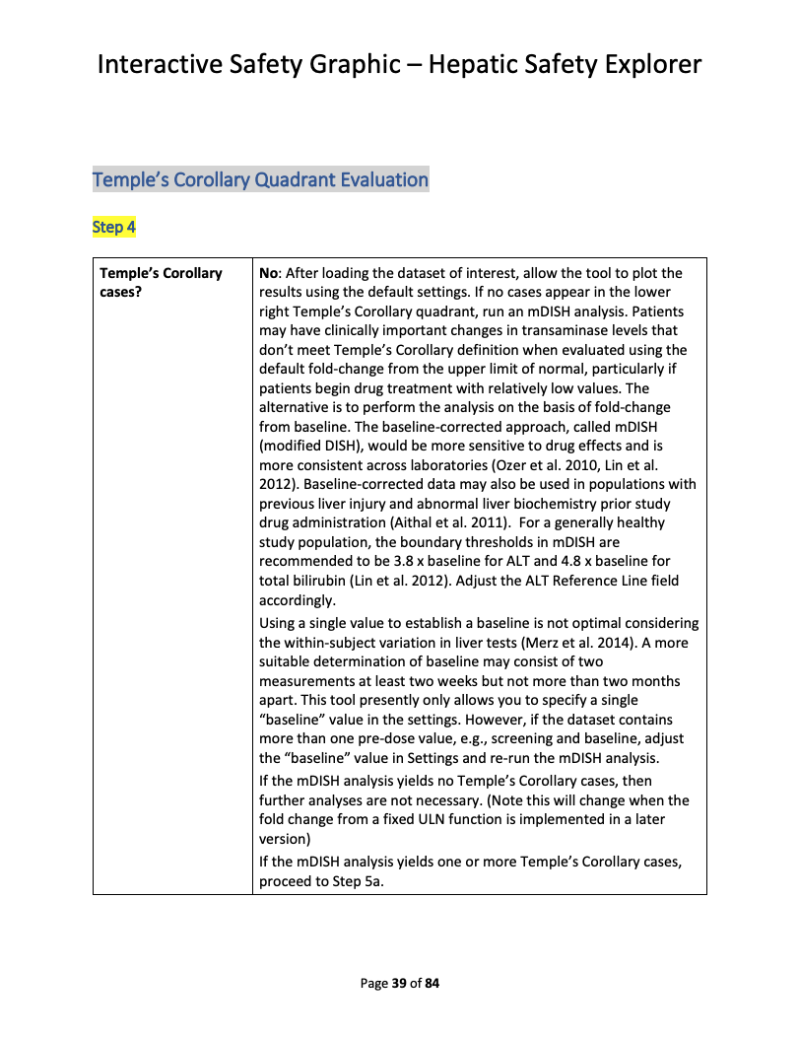
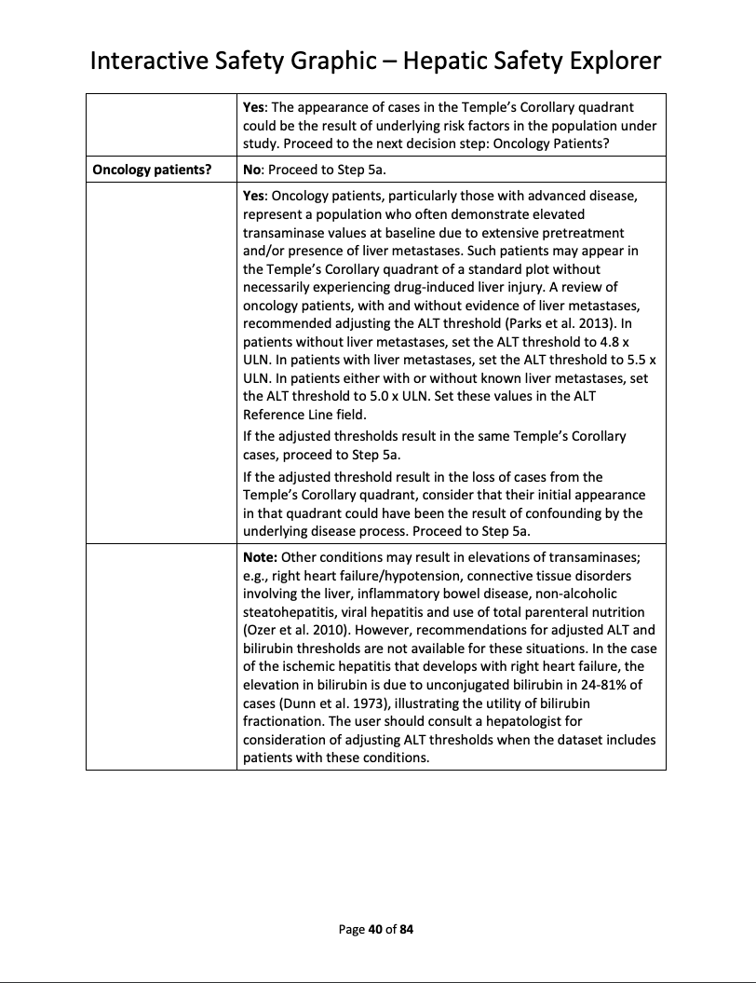
Hepatic Safety Explorer
Demo – Repo – Clinical Workflow – Paper

Slide 11
{safetyGraphics} v1.0 - Lessons Learned
Lab Data only
HTML Widgets only
Adding New Charts
Testing in Shiny
- Saving Customizations
Use R For Data Load/Config
Shared Data and Settings
Flexible data standards
Modular Shiny Framework
Exported HTML Reports
What Worked
Updates Needed

Slide 12




Medical Monitoring
Data Exploration
Data Monitoring Committee
Risk-Based Monitoring?
Notes:
Medical Monitoring
Data Exploration – Supplemental tool for analysts.
Data Monitoring Committee - Novartis submitted graphics to DMC.
Risk-based Monitoring?

Slide 13
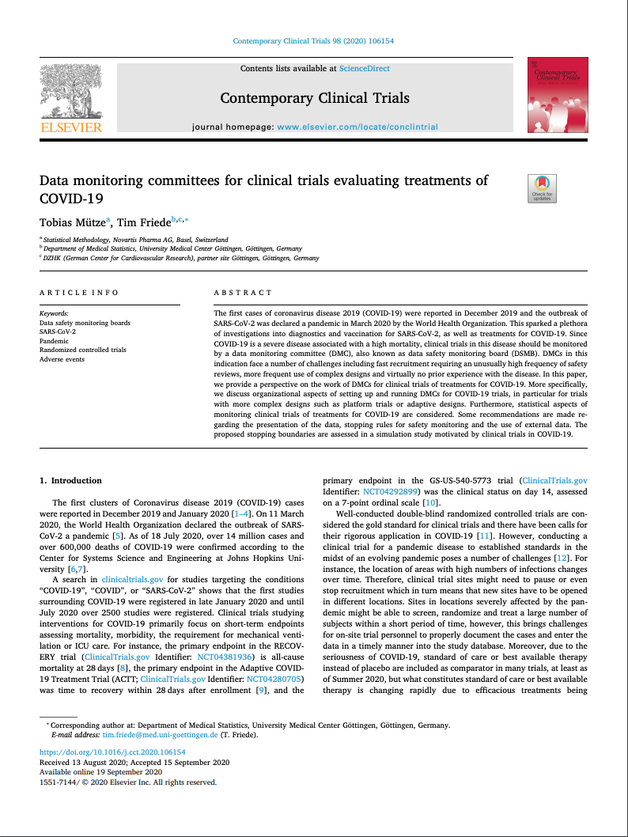
The Safety Explorer Suite: Interactive Safety Monitoring for Clinical Trials, Wildfire et al. 2018
Paper - Repo
A New Paradigm for Safety Signal Detection and Evaluation Using Open-Source Software Created by an Interdisciplinary Working Group. 2021 Buchanan
Paper – Repo
Data Monitoring committees for clinical trials evaluating treatments of COVID-19. Tobias Mütze and Tim Friede. 2020 - Paper

Slide 14
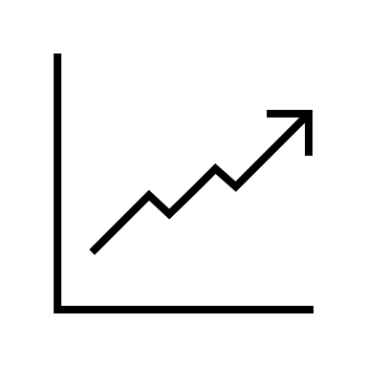

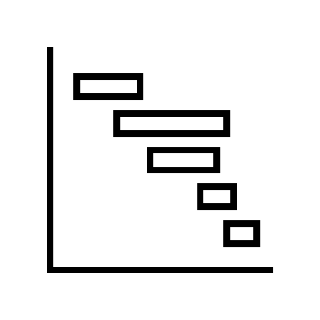
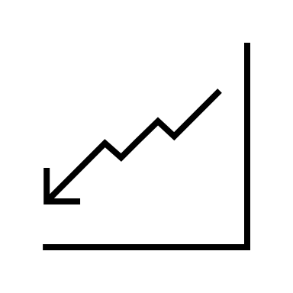



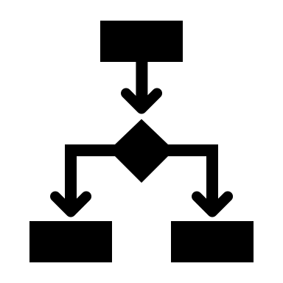



New Charts
Qualification
Deployment
Notes:
More Charts - Expand Chart Coverage to new safety domains
Qualification – Create Qualification Guidelines
Deployment – Run Pilots with interested stakeholders

Slide 15
Vignettes
Intro Vignette - Introductory vignette providing the overview of the package.
Chart Configuration Vignette - Details about the charting process including technical specifications and step-by-step instructions.
Cookbook Vignette - A series of examples showing how to initialize the safetyGraphics Shiny app in different scenarios.
Technical FAQ Vignette - Vignette discussing security, validation and other technical issues.
Link: https://github.com/safetygraphics/safetygraphics/wiki

Slide 16
safetyGraphics Package Ecosystem
The {safetyGraphics} platform displays charts from {safetyCharts}.
{safetyGraphics} – Reusable Shiny App for safety monitoring
{safetyCharts} – Reusable stand-alone charts for safety monitoring
{safetyData} – Sample AdAM and SDTM datasets for examples and testing.

Slide 17
01. Hello World
Run the app with default data, or load data and select charts with a simple GUI
Notes:
1

Slide 18
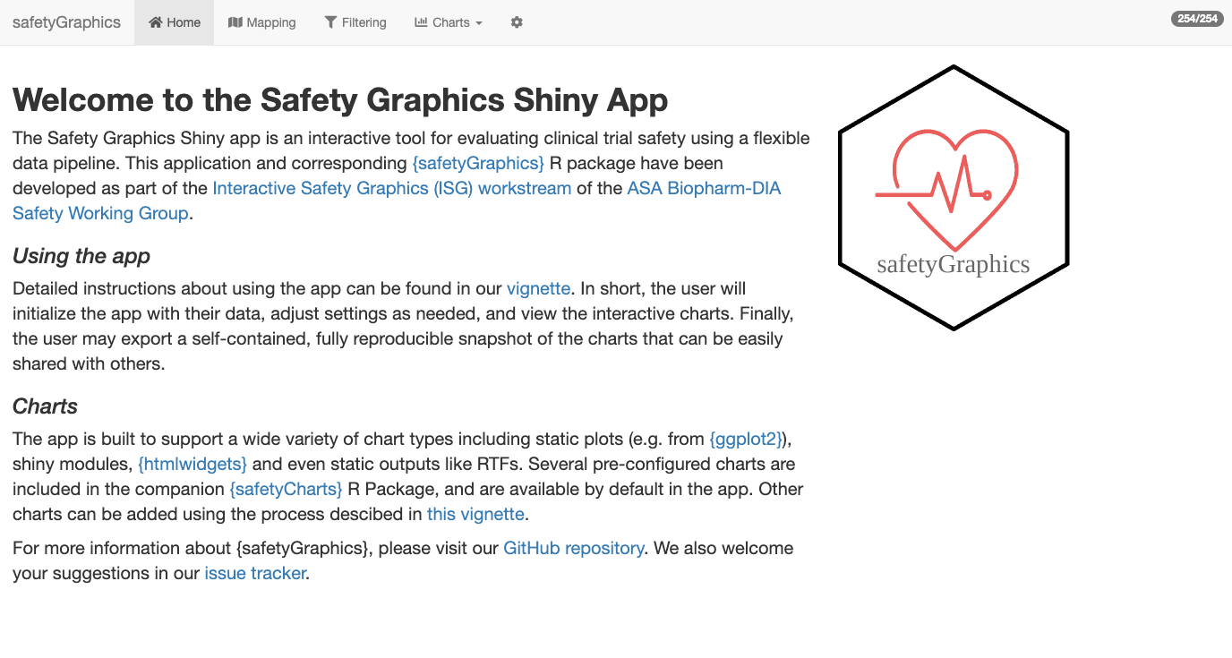
Hello World
01_HelloWorld.R
install.packages('safetyGraphics’)
library(safetyGraphics)
safetyGraphicsApp()

Slide 19
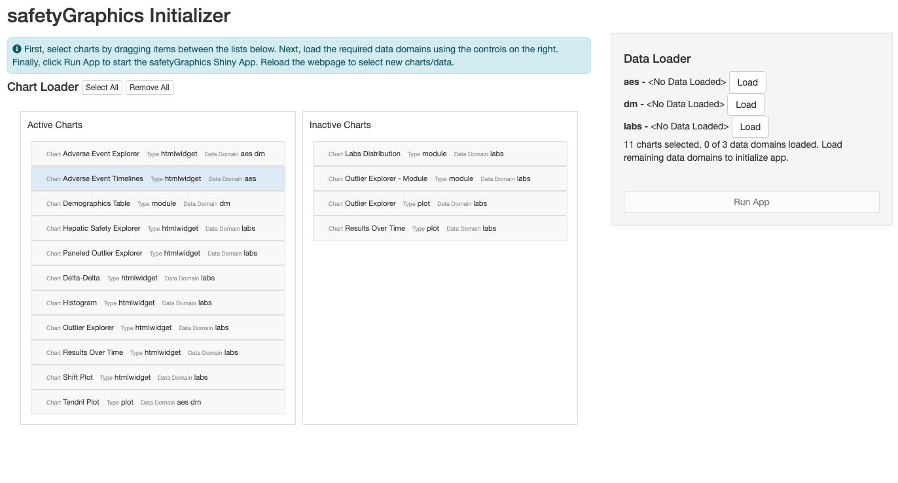
Hello World, Again
01_HelloWorld.R
install.packages('safetyGraphics’)
library(safetyGraphics)
safetyGraphicsInit()

Slide 20
Breakout #1 – Hello World
01_HelloWorld.R
Objectives
Launch the app with `safetyGraphicsApp()`
Familiarize yourself with the basic layout and tab content
Try out the `safetyGraphicsInit()` workflow using sample data

Slide 21
02. Loading Custom Data
Create a reusable R script to load your own data and save a data mapping.

Slide 22
?safetyGraphicsApp docs
safetyGraphicsApp(
domainData = list(
labs = safetyData::adam_adlbc,
aes = safetyData::adam_adae,
dm = safetyData::adam_adsl
),
meta = safetyGraphics::meta,
charts = NULL,
mapping = NULL,
autoMapping = TRUE,
filterDomain = "dm",
chartSettingsPaths = NULL
)
domainData | named list of data.frames to be loaded into the app. Sample AdAM data from the safetyData package used by default
charts | list of charts in the format produced by safetyGraphics::makeChartConfig()
mapping | list specifying the initial mapping values for each data mapping for each domain (e.g. list(aes= list(id_col='USUBJID', seq_col='AESEQ')).
autoMapping | boolean indicating whether the app should attempt to automatically detect data standards and generate mappings for the data provided. Values specified in the mapping parameter overwrite automatically generated mappings when both are found. Defaults to true.
meta | data frame containing the metadata for use in the app. See the preloaded file (?safetyGraphics::meta) for more data specifications and details. Defaults to safetyGraphics::meta.
filterDomain | domain used for the data/filter tab. Demographics ("dm") is used by default. Using a domain that is not one record per participant is not recommended.
chartSettingsPaths | path(s) where customization functions are saved relative to your working directory. All charts can have initialization (e.g. myChart_Init.R) and static charts can have charting functions (e.g. myGraphic_Chart.R). All R files in this folder are sourced and files with the correct naming convention are linked to the chart. See the Custom Charts vignette for more details.

Slide 23
safetyGraphicsApp() – Configurable Inputs
domainData – Domain-level Study Data
mapping – List identifying the key columns/fields in your data
charts – Define the charts used in the app.
meta – Metadata table with info about required columns and fields

Slide 24





Domain Data
Interactive Graphics
Charts
Metadata + Mapping

Slide 25
safetyGraphicsApp() – domainData
domainData
mapping
charts
meta
Pass study data to the app with the `domainData` parameter
domainData is a named list of `data.frame` or `tibble` objects.
Each item in the list stores data for a single data domain.
AdAM data from {safetyData} for 3 domains (labs, aes, dm) is used by default:
Additional domains can be added using `meta` (see section 5 in this workshop)
# domainData default
list(
labs = safetyData::adam_adlbc,
aes = safetyData::adam_adae,
dm = safetyData::adam_adsl
)

Slide 26
Examples 2.1 / 2.2 / 2.3
02_CustomData.R
Objective - Gain experience initializing the app with different data types
Example 2.1 – Initialize app with SDTM data (instead of ADaM)
Example 2.2 – Load a single data domain
Example 2.3 – Load a SAS Transport data set

Slide 27
safetyGraphicsApp() – mapping
domainData
mapping
charts
meta
Specify Columns and Fields in your data with the `mapping` parameter
`mapping` is a list that pre-specifies column and field names found in `domainData`.
Users must provide mappings, or generate one in the app. (There is no default).
Here is an example of a simple custom mapping:
`mappings` can be viewed and adjusted on the mapping tab, and can be exported from the settings tab.
The app generates an “automapping” using common data standards, but …
… the `mapping` parameter takes precedence over “automapping”. (see `?detectStandard` for more)
Details about mappings are stored in the `meta` parameter. See Section 5 of this workshop for details.
# sample mapping
list(
aes= list(id_col='USUBJID', seq_col='AESEQ')
labs= list(measure_col = 'customMeasureCol')
)

Slide 28
Example 2.4
02_CustomData.R
Objective - Gain experience with custom data mappings
Example 2.4 – Make a slight modification to our default data, and then account for the change using a custom mapping.

Slide 29
Breakout #2 – Custom Data + Mapping
02_Excercise.R
Objectives
Load non-standard data in the app
Create a custom mapping to simplify app configuration

Slide 30
03. App/Chart Export
Export Code to reproduce the whole app or individual charts

Slide 31
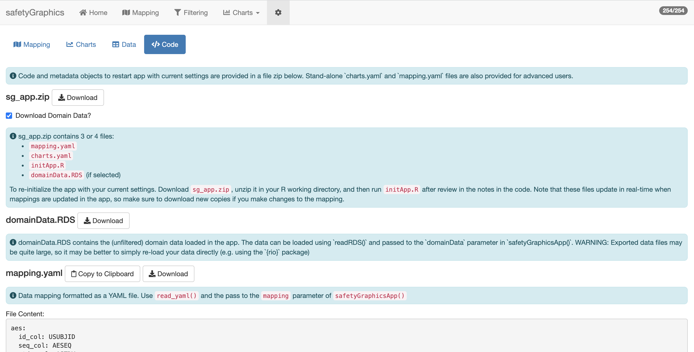
App Export
https://github.com/SafetyGraphics/safetyGraphics/wiki/ChartConfiguration

Slide 32
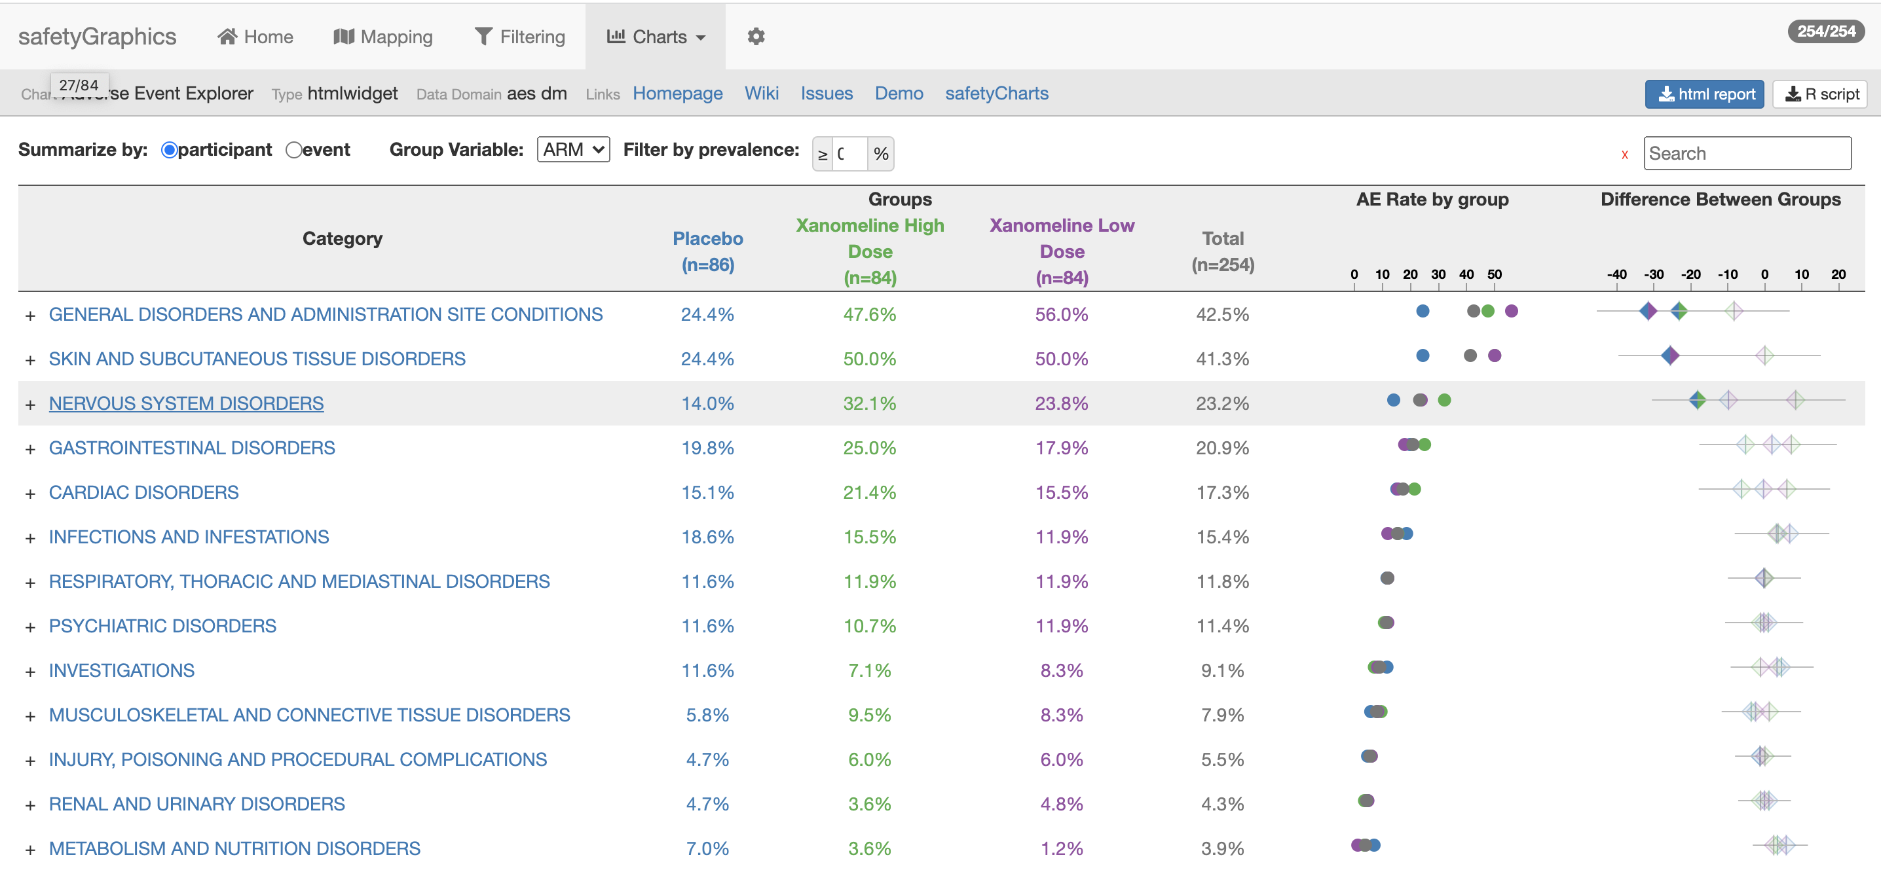
Chart Export

Slide 33
Optional Exercise
03_Excercise.R
Objective
Export a chart
Manually customizing chart code after export
Notes:
\

Slide 34
04. Customizing Charts
Select from existing charts in the safetyCharts package or add your own!
Notes:
3

Slide 35
safetyGraphicsApp() – mapping
domainData
mapping
charts
meta
Define charts in the app with the `charts` parameter
`charts` is a complex list that defines which charts are used in the app.
Charts defined in the `safetyCharts` package are included by default (see ?makeChartConfig)
Many types of chart are supported including htmlwidgets, shiny modules and static charts and tables.
Users can create custom charts by defining a `config` object and a `chart` function.
The Custom Chart vignette describes the chart workflow in detail.

Slide 36
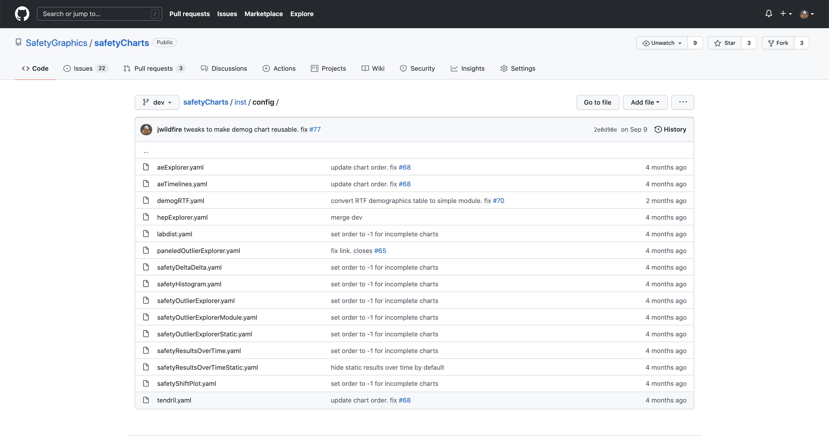
Default Charts from safetyCharts

Slide 37
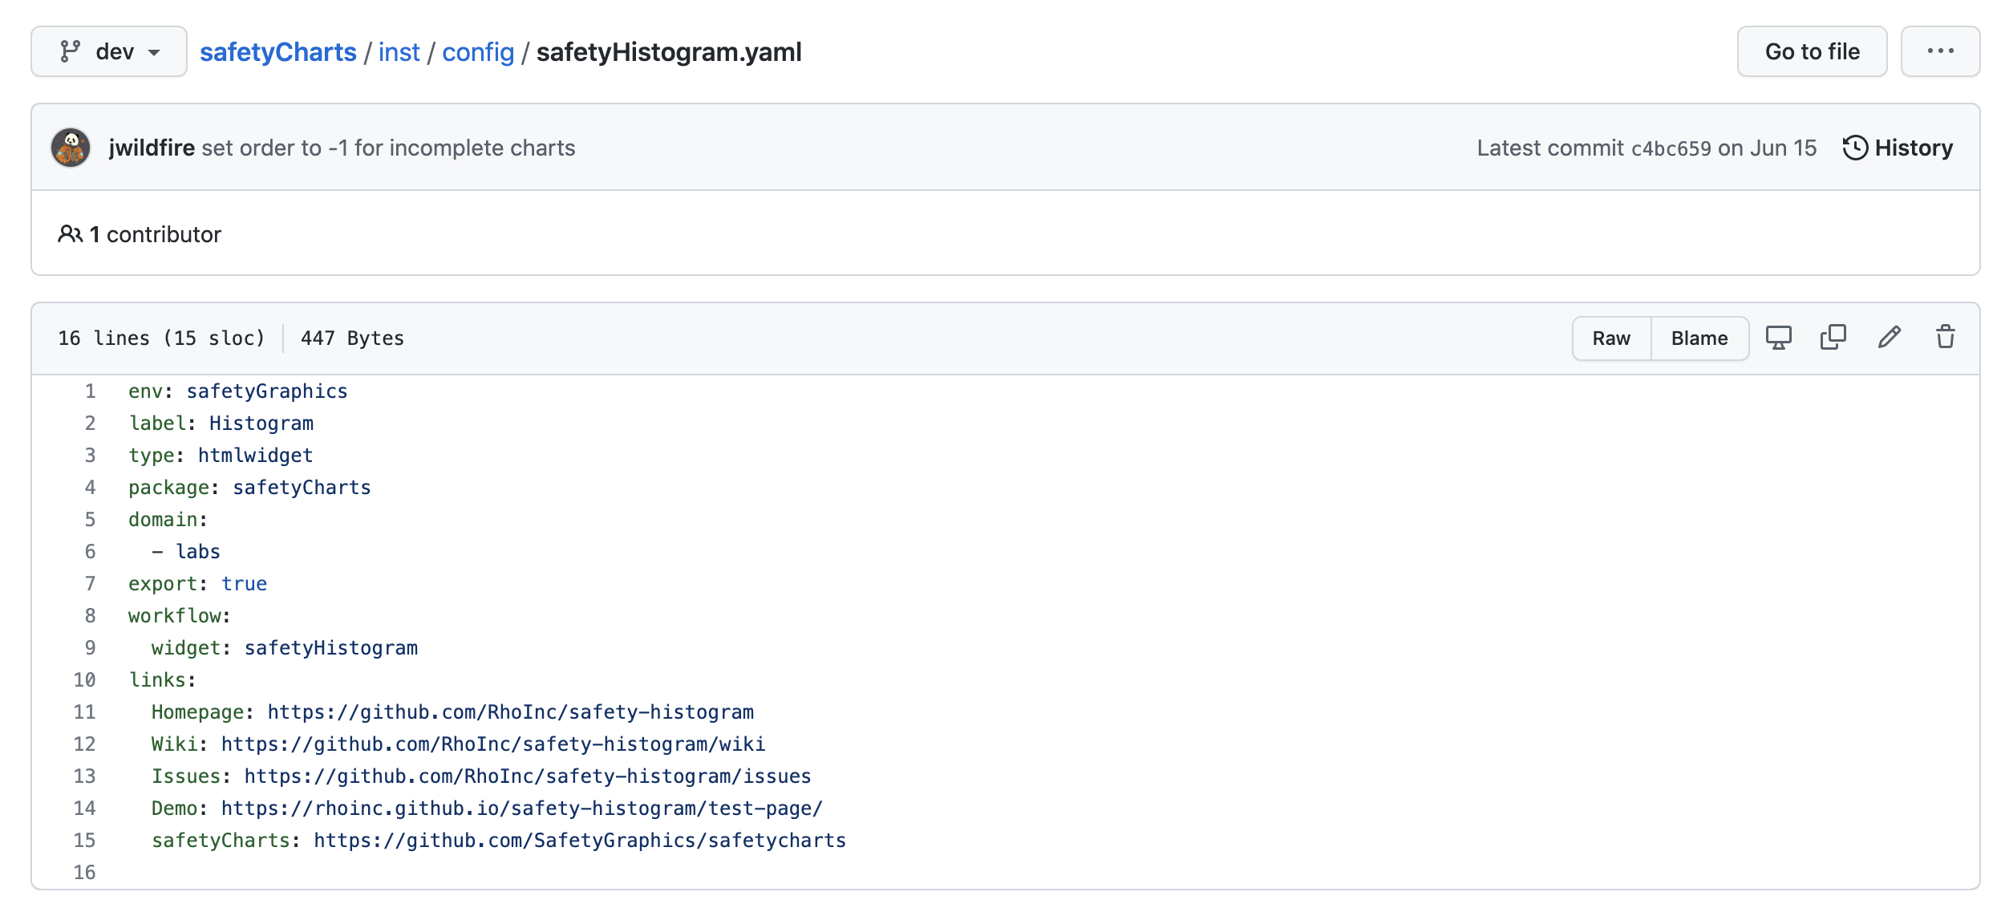
Default Charts from safetyCharts

Slide 38
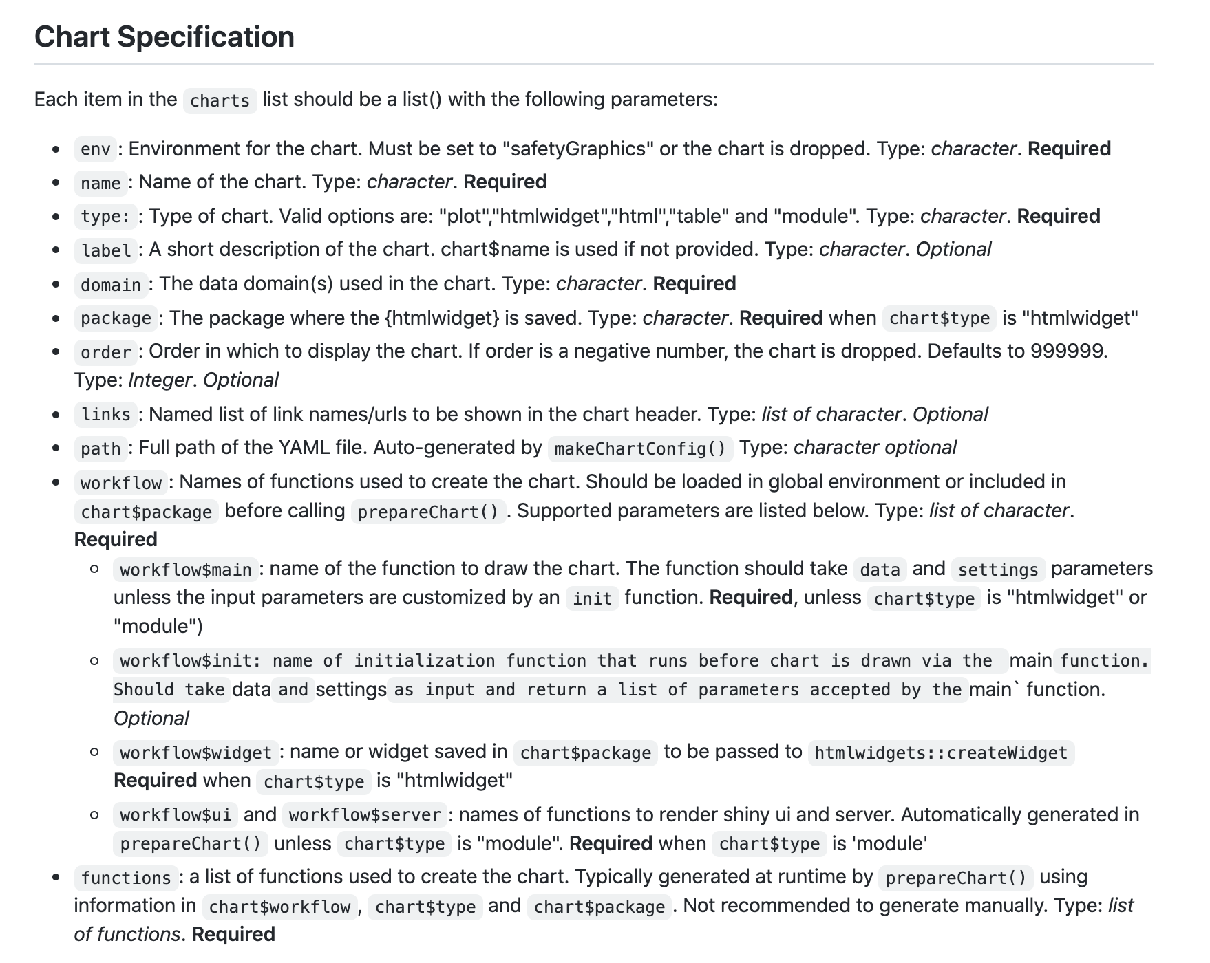
Link to wiki

Slide 39
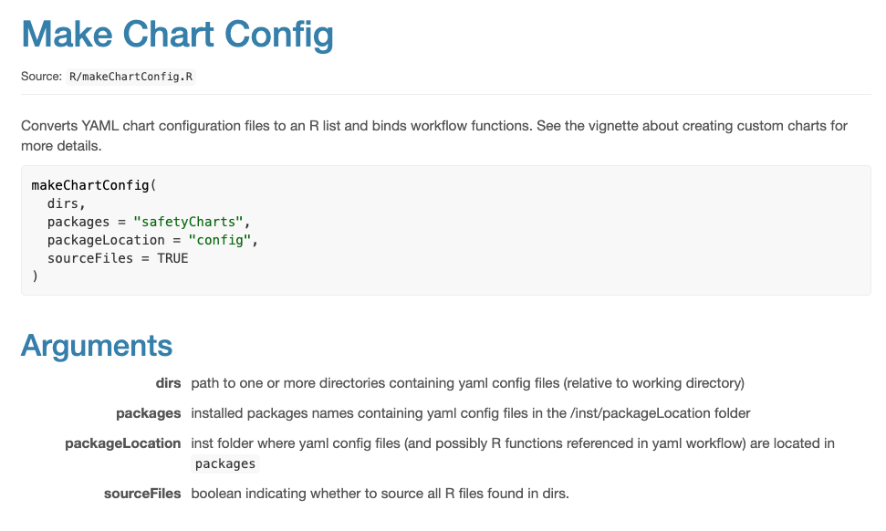
?makeChartConfig

Slide 40
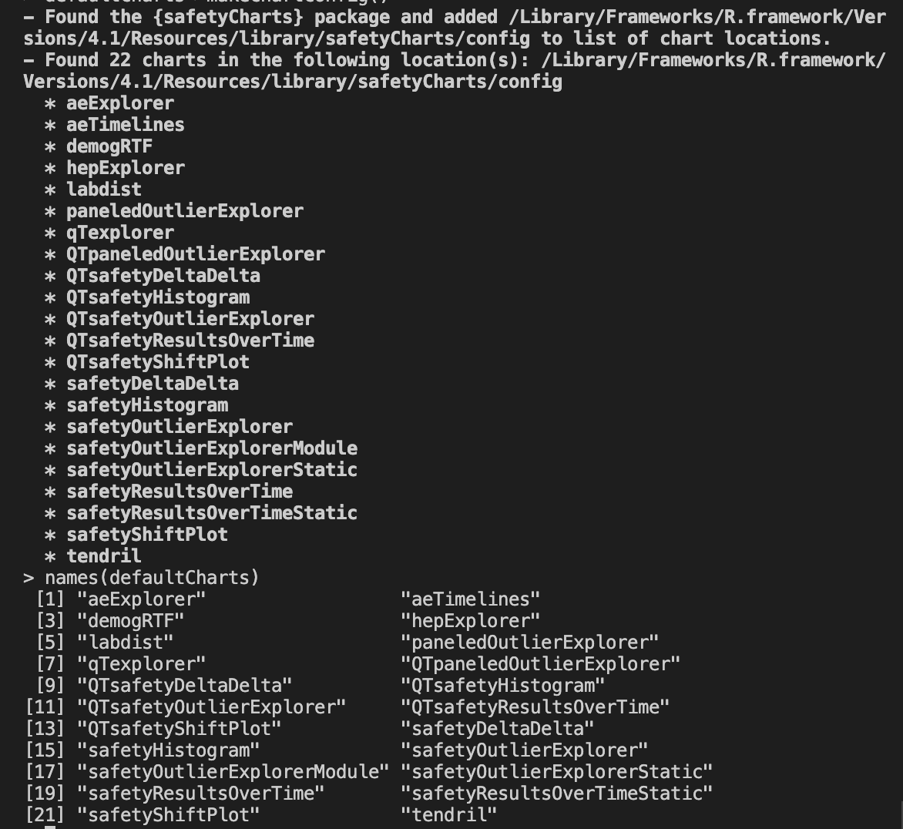
> # load charts from safetyCharts
> defaultCharts <- safetyGraphics::makeChartConfig()

Slide 41
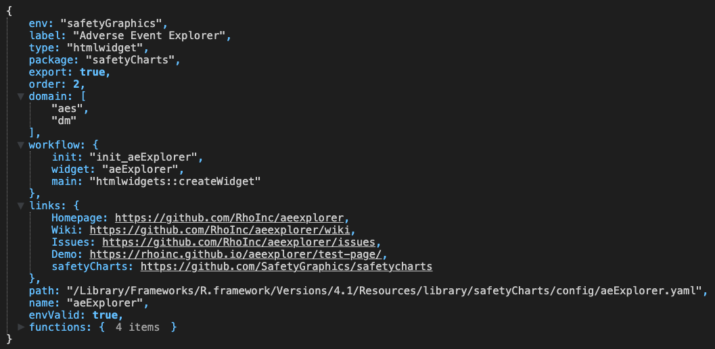
> # load charts from safetyCharts
> defaultCharts <- safetyGraphics::makeChartConfig()
> View(defaultCharts[[1]])

Slide 42
Examples 4.1 / 4.2
04_CustomCharts.R
Objective – Customize the default charts from safetyCharts
Example 4.1 – Drop unwanted charts
Example 4.2 – Edit metadata for a default chart

Slide 43
Breakout #3 – Update Default Charts
04_Excercise1.R
Objectives
Practice configuring default charts

Slide 44
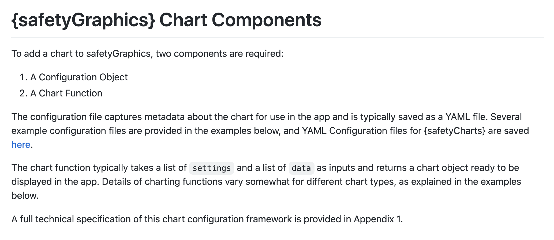
Adding Charts - Custom Chart Vignette
https://github.com/SafetyGraphics/safetyGraphics/wiki/ChartConfiguration

Slide 45
Link to wiki

Slide 46
Example 4.3 - Hello World
04_CustomCharts.R
Chart Function
Chart config
helloWorld <- function(data, settings){
plot(-1:1, -1:1)
text(
runif(20, -1,1),
runif(20, -1,1),
"Hello World”
)
}
helloworld_chart<-list(
env="safetyGraphics",
name="HelloWorld",
label="Hello World!",
type="plot",
domain="aes",
workflow=list(
main="helloWorld"
)
)
Run App
> safetyGraphicsApp(charts=list(helloworld_chart))

Slide 47
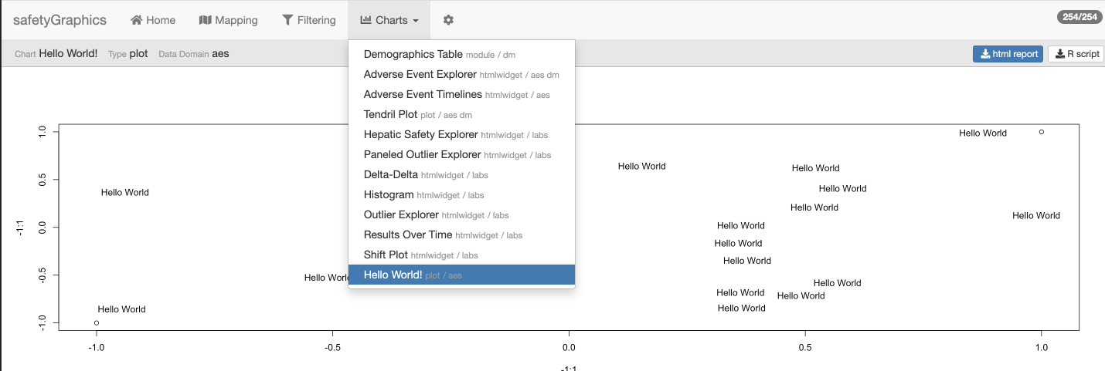

Slide 48
Reusable Chart Functions & the Tidyverse
Many tidyverse packages (including dplyr and ggplot2) require some modification when used in functions. To make a long story short:
We recommend using the .data[[]] pronoun in safetyGraphics chart functions.
col_summary <- function(df, col) {
ggplot(df) +
geom_bar(aes(x = .data[[col]])) +
coord_flip()
}
col_summary(mpg, "drv")
mpg_drv_summary <- function() {
ggplot(ggplot2::mpg) +
geom_bar(aes(x = drv)) +
coord_flip()
}
For more details see: Using ggplot2 in packages , Programming with dplyr and the functional programming chapters in Advanced R

Slide 49
Examples 4.3 / 4.4 / 4.5
04_CustomCharts.R
Objective – Add custom charts to safetyGraphics
Example 4.3 – Hello World Chart
Example 4.4 – Simple custom demographics histogram
Example 4.5 – Lab Outlier Explorer - Static
Example 4.6 (optional) – Lab Outlier Explorer – Shiny Module

Slide 50
Breakout #4 – Custom Chart Creation
04_Excercise2.R
Objectives
Adapt a static chart for use in safetyGraphics

Slide 51
Shiny App
# Start safetyGraphics Shiny App with custom charts
safetyGraphicsApp(charts=myCharts)
myCharts list()
# Make list of all charts in specific location
# Specify ‘path’ or ‘package’ - ‘safetyCharts’ = default
myCharts<-makeChartConfig()
aeExplorer
list(…)
outlierModule
list(…)
…
newChart
list(…)
myCharts$newChart list()
name
‘newChart’
domain
‘labs’
type
‘htmlwidget’
# Add a Single Chart (usually saved as yaml)
# Automatically called for yaml in ‘path’/‘package’
myCharts$newChart<-read_yaml(path)
workflow
list(…)
functions
list(…)
myCharts$newChart$functions list()
# Bind list of functions to a chart
# Specified by chart$workflow, chart$type & chart$package
# Automatically called for yaml in ‘path’/‘package’
myCharts$newChart<-prepareChart(myCharts$newChart)
ui
function()
server
function()
init
function()
main
function(data, settings)
data
list(df1,df2,…)
settings
list(list1,list2,…)
# Data and Setting inputs used in main() and init()
# reactive() in shiny app, but not in exported code.

Slide 52
05. Adding Custom Domains
Customize `metadata` to add data domains to the app, and then create charts using the data!

Slide 53
safetyGraphicsApp() – mapping
domainData
mapping
charts
meta
Customize charts and data configuration with `meta` parameter
`meta` is a dataframe that defines the columns and fields used in safetyGraphics charts
A default set of metadata for Adverse events (‘aes’), lab results (‘labs’) and demographics (‘dm’) is included as `safetyGraphics::meta`
Determines which data domains are included in the app.
Populates mapping tab in shiny app.
`labs`, `dm` and `aes` domains included by default
New domains are added when found in `meta`

Slide 54
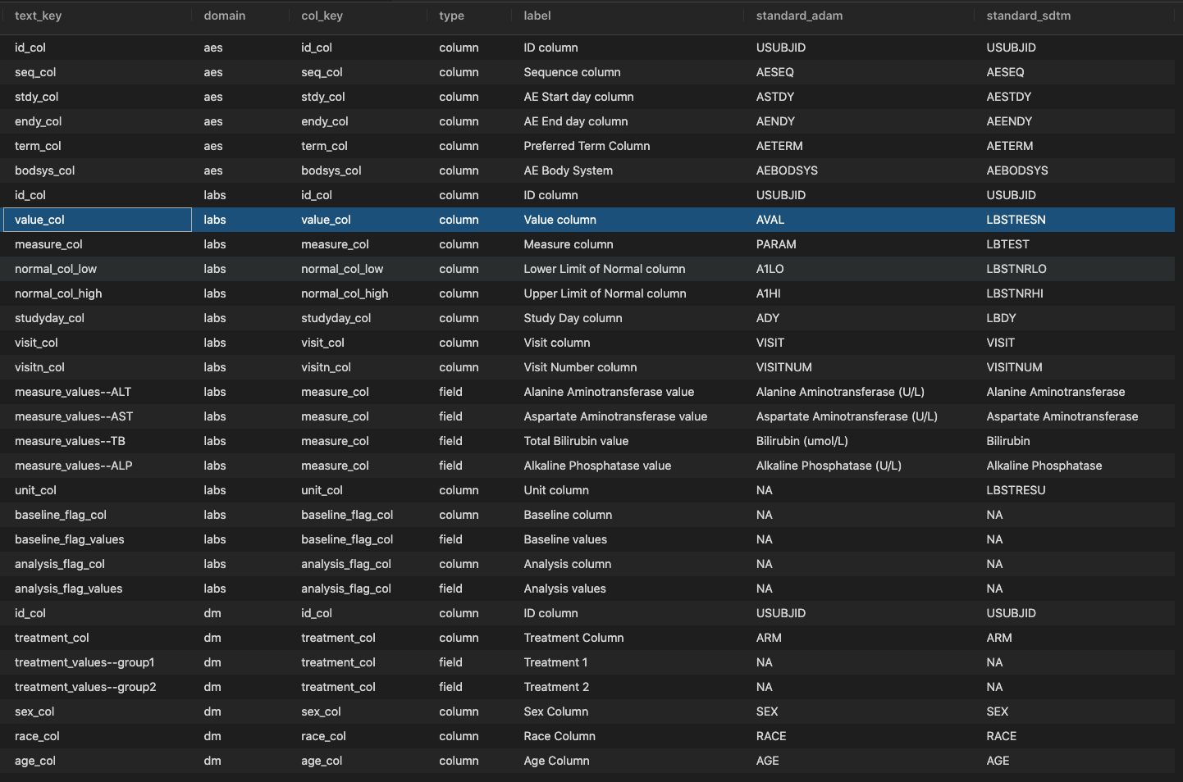
> # view default metadata
> View(safetyGraphics::meta)

Slide 55
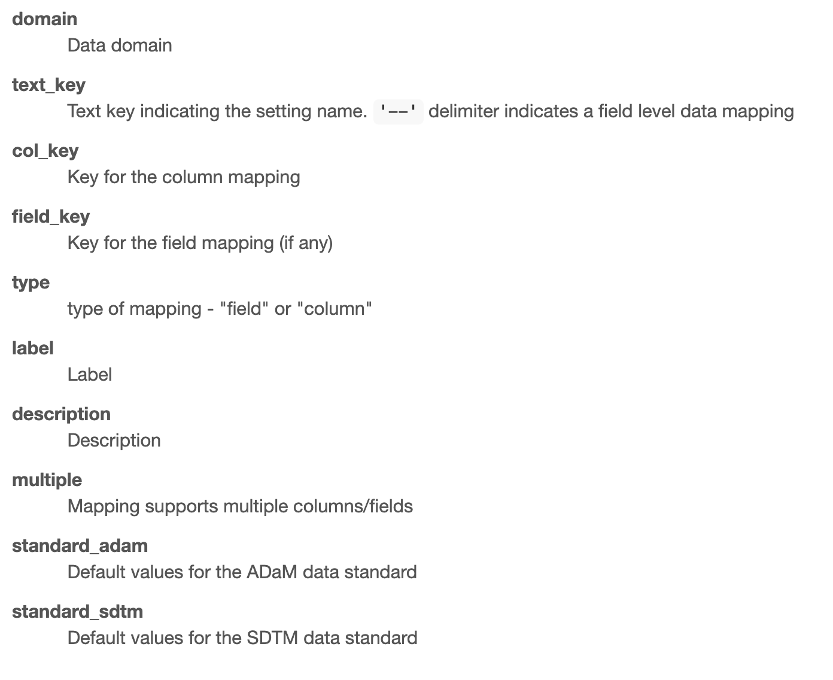
?safetyGraphics::meta Metadata Column Definitions

Slide 56
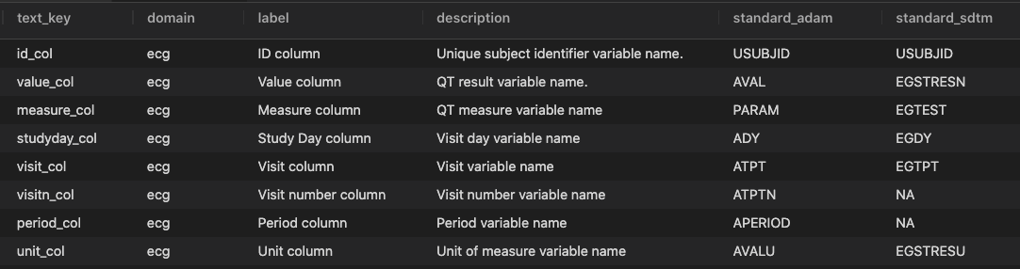
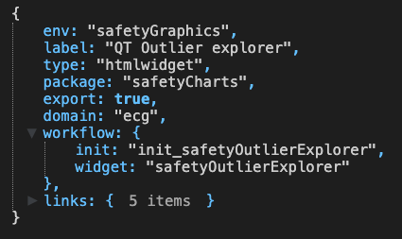
Creating a Chart in a Custom Domain
safetyGraphicsApp(
meta=ecg_meta,
charts=ecg_chart,
domainData=list(ecg=adeg)
)
1
Create metadata for new domain
1
2
3
2
Define a chart using the new domain
3
Load data for the new domain
adeg <- readr::read_csv("https://physionet.org/files/ecgcipa/1.0.0/adeg.csv?download")

Slide 57
Examples 5.1 / 5.2 / 5.3
05_CustomDomain.R
Objective - Gain experience using the `meta` parameter for `safetyGraphicsApp()` to create custom data domains
Example 5.1 – Create a vitals domains using labs as a template
Example 5.2 – Create a hello world domain from scratch
Example 5.3 – Create an ecg domains with custom charts

Slide 58
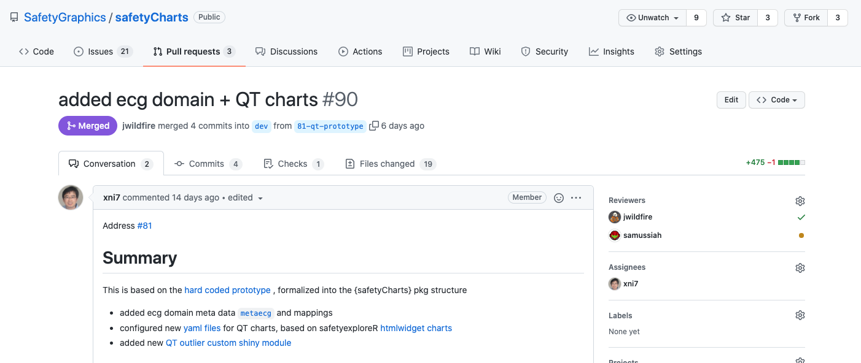
Full implementation of custom ECG domain
https://github.com/SafetyGraphics/safetyCharts/pull/90

Slide 59
Appendix – Shiny Modules Demo

Slide 60
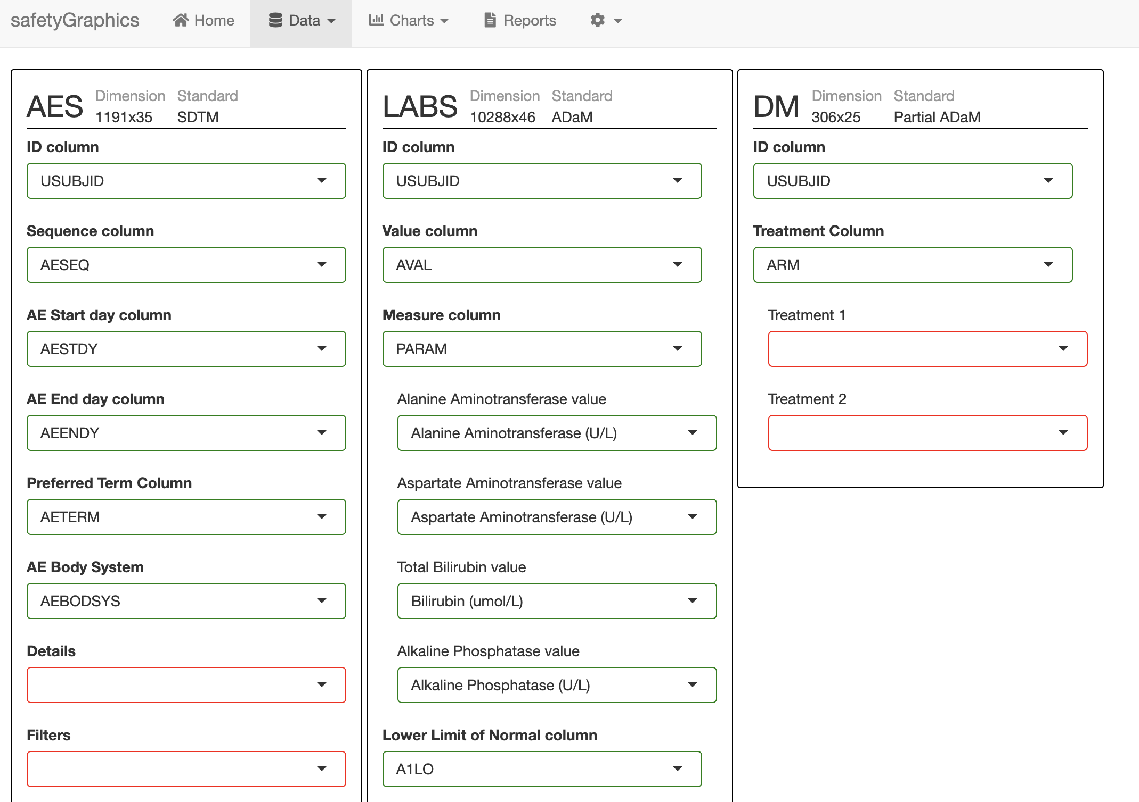
safetyGraphics 2.0 Multiple Data Domains
1 Mapping Tab Module

Slide 61
safetyGraphics 2.0 Multiple Data Domains
3 Domain Modules

Slide 62
safetyGraphics 2.0 Multiple Data Domains
14 Column Modules

Slide 63
safetyGraphics 2.0 Multiple Data Domains
20 Select Modules

